Slide 1
Checking understanding of multiplicative relationships
Understanding multiplicative relationships: fractions and ratio

Slide 2
how to use Oak lessons

Slide 3
I can use proportionality as a comparison rather than just absolute values.

Slide 4
Proportion is a part to whole (sometimes part to part) comparison. If two things are proportional then the ratio of part to whole is maintained and the multiplicative relationship between parts is also maintained.

Slide 5
Proportionality means when variables are in proportion if they have a constant multiplicative relationship.

Slide 6

Checking understanding of multiplicative relationships
Comparing using proportion
Paying attention to the whole

Slide 7
Comparing using proportion
Proportion is a part to whole (sometimes part to part) comparison.
You may have seen proportions being represented as fractions, decimals, percentages and ratios.

Slide 8

Comparing using proportion
Proportion is a part to whole (sometimes part to part) comparison.
What proportion of the whole square is shaded?
As a fraction:
shadedpart
whole

Slide 9
Comparing using proportion
Proportion is a part to whole (sometimes part to part) comparison.
0.01
1
What proportion of the whole square is shaded?
As a decimal:
0.25 is shaded
0.25
1 is the whole

Slide 10
Comparing using proportion
Proportion is a part to whole (sometimes part to part) comparison.
1%
What proportion of the whole square is shaded?
As a percentage:
25 are shaded
25%
100 is the whole

Slide 11
Comparing using proportion
Proportion is a part to whole (sometimes part to part) comparison.
What is the ratio of shaded to unshaded?
For every 1 shaded there are 3 unshaded

Slide 12
Comparing using proportion
Proportion is a part to whole (sometimes part to part) comparison.
Example
Fraction
Example
Decimal
Example
Percentage
Example
Ratio
For every 1 shaded there are 3 unshaded
0.25
25%
Fractions are sometimes an easier way to write and compare proportions.

Slide 13
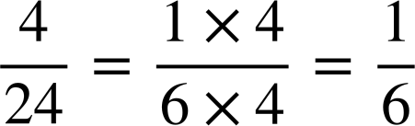
Comparing using proportion
Jun and Alex want to find out what proportion is £4 from £24
Whose approach is correct?
£24
£4 | £4 | £4 | £4 | £4 | £4
Alex says “Using a bar model, I can see £4 fits exactly into £24, 6 times.
This means £4 is of £24.”
Jun says “ simplifies to
This means £4 is of £24.”
Both are correct!

Slide 14
Comparing using proportion
A full time Oak teacher receives £4000 a month.
She gets a pay rise, so earns £4500 a month.
A part time Oak teacher receives £400 a month.
He gets a pay rise, so earns £800 a month.
Who has the best pay rise?

Slide 15
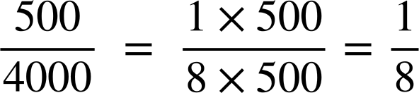
Comparing using proportion
A full time Oak teacher receives £4000 a month.
She gets a pay rise, so earns £4500 a month.
Visualising this as a bar model we have:
Full time teacher:
£4000
£500
£500
£500
£500
£500
£500
£500
£500
Each £500 represents , so it is a pay rise.

Slide 16
Comparing using proportion
A full time Oak teacher receives £4000 a month.
She gets a pay rise, so earns £4500 a month.
Using fractions and simplifying,
Full time teacher:
Amount received
The full time teacher receives a pay rise of her salary.
The whole salary per month

Slide 17
Comparing using proportion
A full time Oak teacher receives £4000 a month.
She gets a pay rise, so earns £4500 a month.
A part time Oak teacher receives £400 a month.
He gets a pay rise, so earns £800 a month.
Who has the best pay rise?
£400
Part time teacher:
£400
Each £400 represents 1 whole, so it is a 100% pay rise.

Slide 18
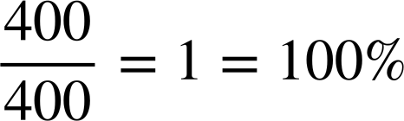
Comparing using proportion
A full time Oak teacher receives £4000 a month.
She gets a pay rise, so earns £4500 a month.
A part time Oak teacher receives £400 a month.
He gets a pay rise, so earns £800 a month.
Who has the best pay rise?
Full time teacher:
Part time teacher:
The full time teacher receives a pay rise of her salary.
Amount received
The whole salary per month

Slide 19
Comparing using proportion
A full time Oak teacher receives £4000 a month.
She gets a pay rise, so earns £4500 a month.
A part time Oak teacher receives £400 a month.
He gets a pay rise, so earns £800 a month.
Who has the best pay rise?
The part time teacher
Full time teacher:
Part time teacher:
The full time teacher receives a pay rise of her salary.
The part time teacher receives a 100% pay rise of his salary.

Slide 20
Comparing using proportion
1) By subdividing the bar models, work out what £3 is as a proportion of the whole amount.
a)
b)
c)
£30
£12
£15

Slide 21
Comparing using proportion
2) By simplifying fractions, work out:
a) what proportion £12 is out of £40?
b) what proportion £12 is out of £15?
c) what proportion £12 is out of £12?

Slide 22
Comparing using proportion
3) Test A is out of 20. Laura gets 12 out of 20 correct.
Test B is out of 50. Sofia gets 40 out of 50.
Who got a higher proportion of answers correct?

Slide 23
Comparing using proportion
4) Here is a table showing pay increases in allowances.
Which pupil got the best allowance increase and why?
Pupil | Normal allowance per month | Increase
Aisha | £15 | £6
Andeep | £10 | £2.50
Izzy | £12 | £4
Jacob | £30 | £6

Slide 24
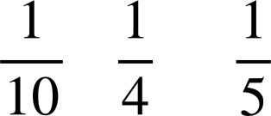
Comparing using proportion
1) By subdividing the bar models, work out what £3 is as a proportion of the whole amount.
a)
b)
c)
£30
£3 is of £30
£3 | £3 | £3 | £3 | £3 | £3 | £3 | £3 | £3 | £3
£12
£3 | £3 | £3 | £3
£3 is of £12
£15
£3 | £3 | £3 | £3 | £3
£3 is of £15

Slide 25
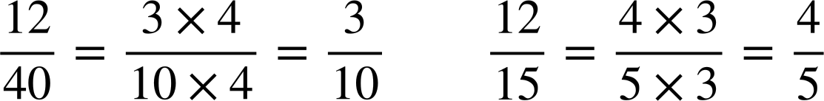
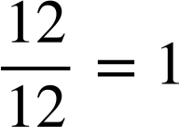
Comparing using proportion
2) By simplifying fractions, work out:
a) what proportion £12 is out of £40?
b) what proportion £12 is out of £15?
c) what proportion £12 is out of £12?

Slide 26
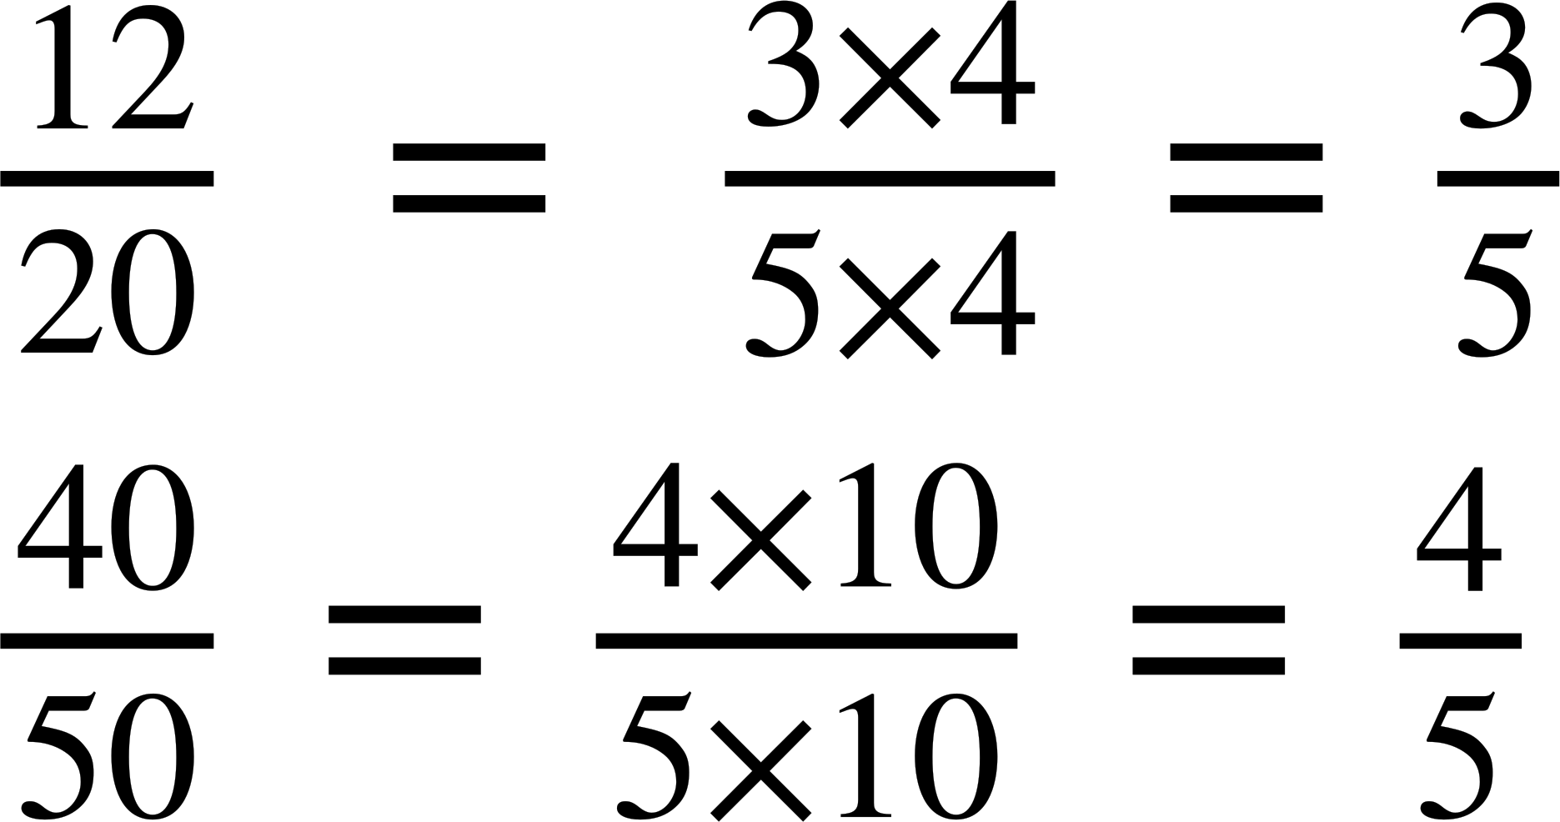
Comparing using proportion
3) Test A is out of 20. Laura gets 12 out of 20 correct.
Test B is out of 50. Sofia gets 40 out of 50.
Who got a higher proportion of answers correct?
Sofia got the highest proportion of answers correct.
Laura:
Sofia:
This represents the proportion Laura got correct.
This represents the proportion Sofia got correct.

Slide 27

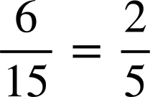
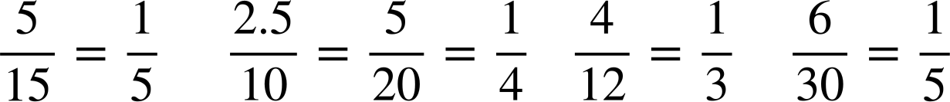
Comparing using proportion
4) Which pupil got the best allowance increase and why?
Pupil | Normal allowance per month | Increase | Proportion of normal allowance
Aisha | £15 | £6
Andeep | £10 | £2.50
Izzy | £12 | £4
Jacob | £30 | £6

Slide 28
Checking understanding of multiplicative relationships
Comparing using proportion
Paying attention to the whole

Slide 29
Paying attention to the whole
When using proportionality as a comparison, attention must be paid to the whole rather than assuming the measure of proportion is the absolute value.
Example
Alex gets 50% in test A.
Aisha gets 30% in test B.
Who has done better?
Example
Alex gets 50% in test A. Test A has 4 questions.
Aisha gets 30% in test B. Test B has 100 questions.
Who has done better?
Aisha has got more answers correct as she did more questions.
There is not enough information to make a comparison as we do not know the total marks in each test.

Slide 30
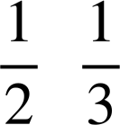
Paying attention to the whole
Lucas and Jun both have a chocolate bar each.
Lucas has a 60 g chocolate bar and Jun has a 30 g chocolate bar.
Lucas eats of his chocolate bar.
Jun eats of his chocolate bar.
Izzy says, “Jun has eaten more chocolate than Lucas because > ”
Explain why Izzy is wrong.
The proportion of Jun’s chocolate bar is greater than the proportion of Lucas’ chocolate bar, but because Lucas’ chocolate bar is twice the size of Jun’s chocolate bar, that means Lucas has eaten more.

Slide 31
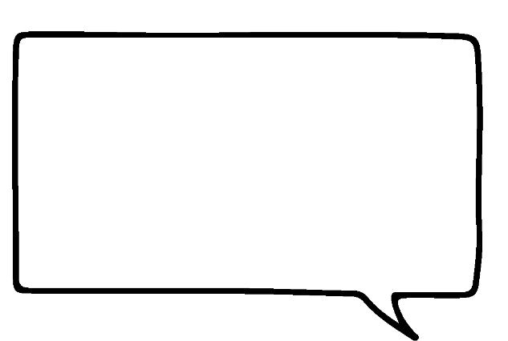


Paying attention to the whole
Jun is asked which of these is greater. Do you agree? Explain.
I choose 300% because it is the highest proportion
2%
100%
Without knowing what the whole is you cannot make an informed choice.
For example, it could be 300% of nothing.
300%

Slide 32
Paying attention to the whole
Which is the greatest amount of money?
This is £20 000
2% of a million pounds
This is £11 000
100% of £11 000
This is £10 000
of £20 000
This is £6000
300% of £2000

Slide 33
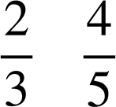
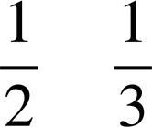
Paying attention to the whole
Insert the correct inequality =, < or > for the following:
50% of 900 > 10% of 4000
>
of 24 < of 60
d) <
e) of 30 < of 50
f) 1% of 900 = 900% of 1

Slide 34
Paying attention to the whole
2) Each pupil in Oak academy has a cashless account.
All Oak pupils have been excellent and the Oak teacher can award them with either 20% more of what is in their account or £2 more what is in their account.
Which offer should each pupil receive to get the best deal?
Pupil | Account
Andeep | £4.50
Aisha | £11.29
Izzy | £9.96
Jacob | £8.90
Jun | £10
Pupil | Account
Lucas | £32
Sam | £8.23
Alex | £2.13
Sofia | £20.12
Laura | £9.99

Slide 35


Paying attention to the whole
3) Tick which is the best offer or if there is not enough information.
Statement | A is better | B is better | Both the same | Not enough information
A is offered 10% of £100 B is offered 5% of £200
A is offered 79% B is offered 100%
A is offered of £24 B is offered of £19
A is offered 20% more than B

Slide 36

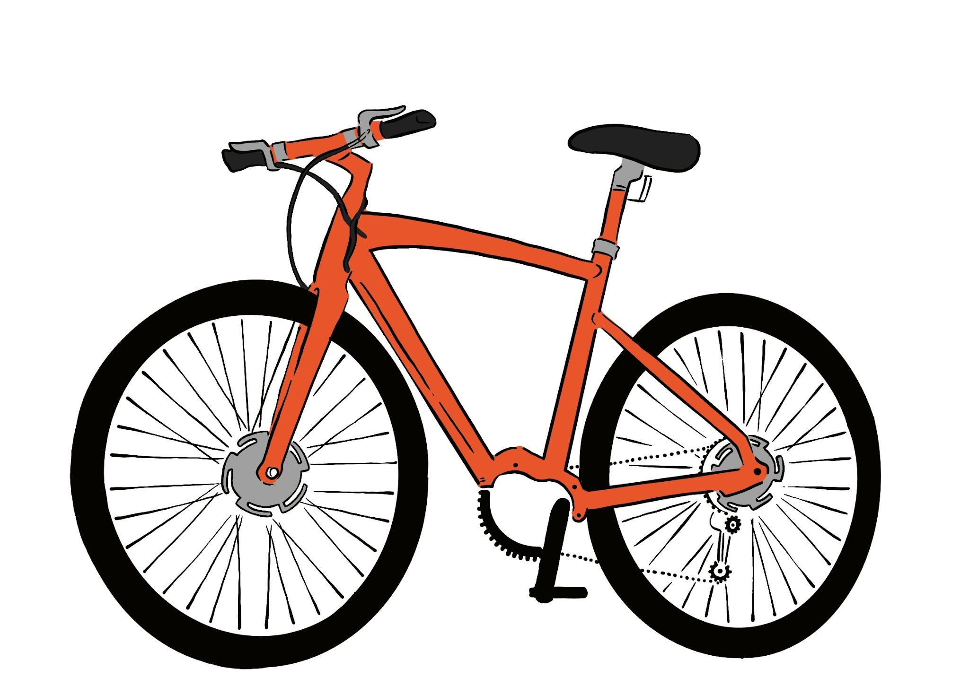
Paying attention to the whole
4) Jacob is looking for a new bike. Two shops sell the same bike.
Shop A
Shop B
£120
£120
SALE 20% off
Plus an extra 10% off the sale price
SALE 30% off
Jacob says, “Both have 30% off in total so the bike costs the same in both shops.”
Show if Jacob is correct or not.

Slide 37
Paying attention to the whole
Insert the correct inequality =, < or > for the following:
50% of 900 > 10% of 4000
>
of 24 < of 60
d) <
e) of 30 < of 50
f) 1% of 900 = 900% of 1

Slide 38
Paying attention to the whole
2) Each pupil in Oak academy has a cashless account.
All Oak pupils have been excellent and the Oak teacher can award them with either 20% more of what is in their account or £2 more what is in their account.
Which offer should each pupil receive to get the best deal?
Pupil | Account
Andeep | £4.50
Aisha | £11.29
Izzy | £9.96
Jacob | £8.90
Jun | £10
Pupil | Account
Lucas | £32
Sam | £8.23
Alex | £2.13
Sofia | £20.12
Laura | £9.99
Anything over £10 should go for the 20% offer. Jun can have either.

Slide 39
Paying attention to the whole
3) Tick which is the best offer or if there is not enough information.
Statement | A is better | B is better | Both the same | Not enough information
A is offered 10% of £100 B is offered 5% of £200
A is offered 79% B is offered 100%
A is offered ⅜ of £24 B is offered ½ of £19
A is offered 20% more money than B

Slide 40
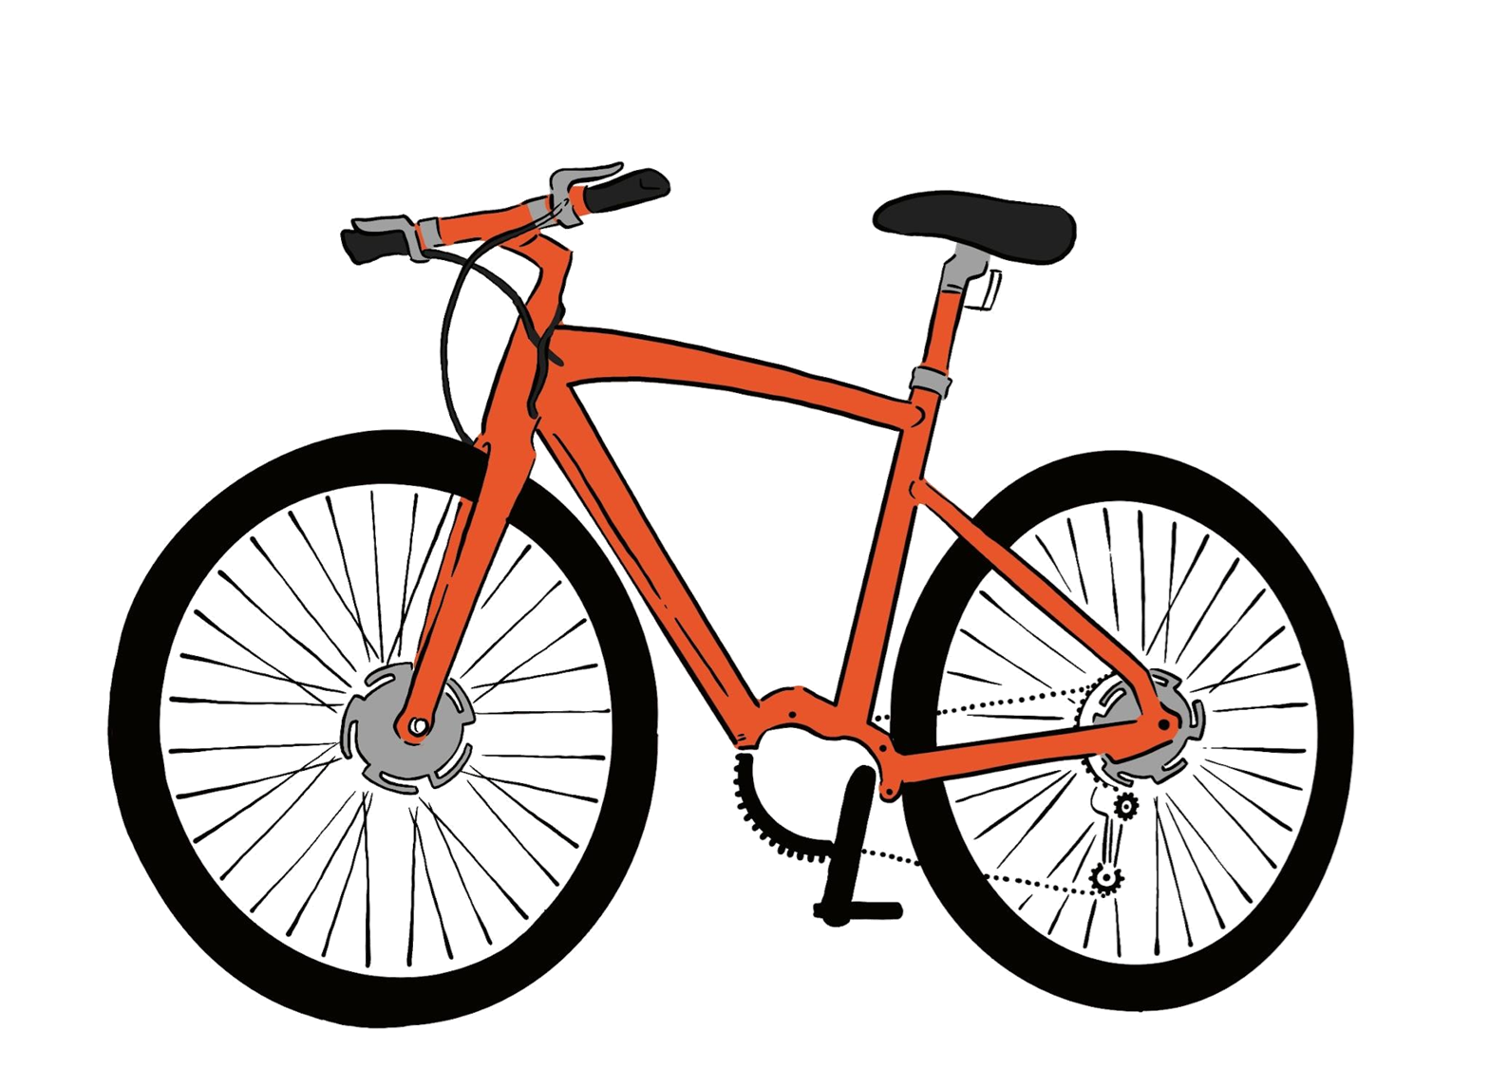
Paying attention to the whole
4) Jacob is looking for a new bike. Two shops sell the same bike.
Shop B
30% of £120 is £36
So the cost of the bike in shop B is:
£120 − £36 = £84
£120
SALE 30% off
Jacob says, “Both have 30% off in total so the bike costs the same in both shops.”
Show if Jacob is correct or not.

Slide 41
Paying attention to the whole
4) Jacob is looking for a new bike. Two shops sell the same bike.
20% of £120 is £24
So the sale price was
£120 − £24 = £96
Now we take 10% off the sale price:
10% of £96 is £9.60
So, in shop A the bike costs:
£96 − £9.60 = £86.40
Shop A
£120
SALE 20% off
Plus an extra 10% off the sale price
Jacob says, “Both have 30% off in total so the bike costs the same in both shops.”
Show if Jacob is correct or not.

Slide 42
Paying attention to the whole
4) Jacob is looking for a new bike. Two shops sell the same bike.
Shop B
Shop A
£120
£120
SALE 30% off
SALE 20% off
Plus an extra 10% off the sale price
£84
£86.40
Jacob says, “Both have 30% off in total so the bike costs the same in both shops.”
Show if Jacob is correct or not.
Jacob is not correct. Taking 20% then 10% is not the same as taking 30% of the same amount.

Slide 43
Checking understanding of multiplicative relationships
Proportion is a part to whole (sometimes part to part) comparison. If two things are proportional then the ratio of part to whole is maintained and the multiplicative relationship between parts is also maintained.
Proportionality means when variables are in proportion if they have a constant multiplicative relationship.
When using proportionality as a comparison, attention must be paid to the whole rather than assuming the measure of proportion is the absolute value.

Slide 44

© Oak National Academy 2023.
Produced in partnership with Mathematics in Education and Industry.
Licensed on the Open Government Licence v3.0, except where otherwise stated. See Oak terms and conditions.

